Slide 1
Introduction to MSP Program
Chirag Sharma
Sai Lakshmi Seemakurthi
Nancy

Slide 2


Slide 3
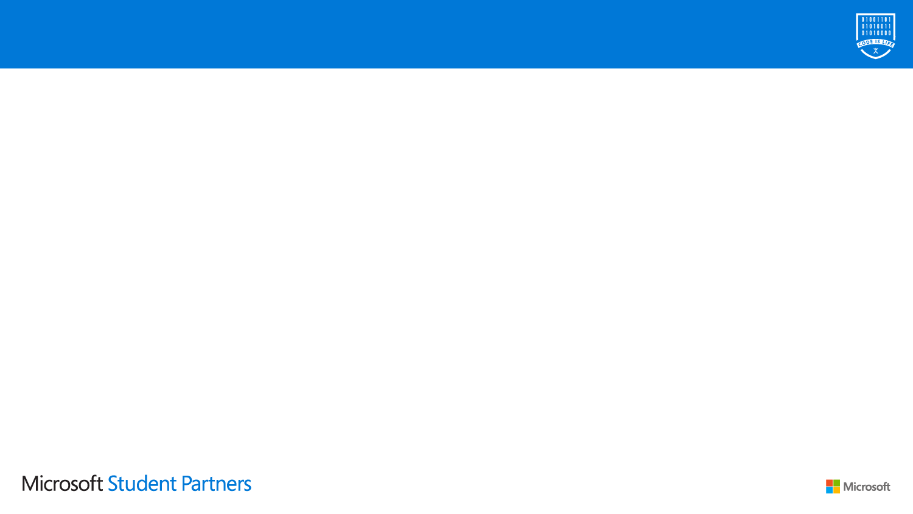
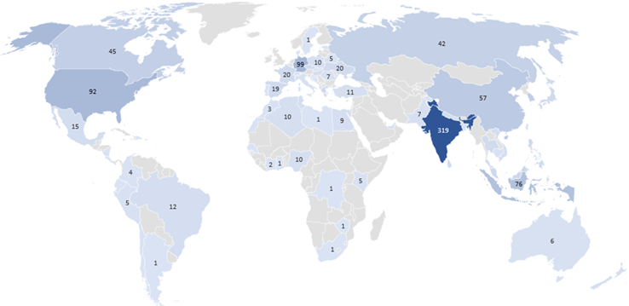
A global community of tomorrow’s leaders
2000+ students across 700+ universities in 70+ countries
Approximately,
95% engineering / computer science
17% pursuing Masters / PhDs
21% female / 79% male

Slide 4
Program Overview
The Microsoft Student Partners program is a global community of university students with a common interest in technology and making a difference in the world around them. Student Partners are a peer to peer learning network, empowered to lead and build communities on their local campuses and share their knowledge and passion for Microsoft technologies with their fellow classmates.
Join – Connect with your teammates and gain access to resources
Learn – Gain knowledge and understanding according to your individualized needs
Execute – Carry out events to influence your community and reinforce your expertise
Share – Share your knowledge by conducting events
Lead – Guide other MSPs along the way and strengthen your coaching
Graduate – Transition from academic to professional with real world expertise

Slide 5
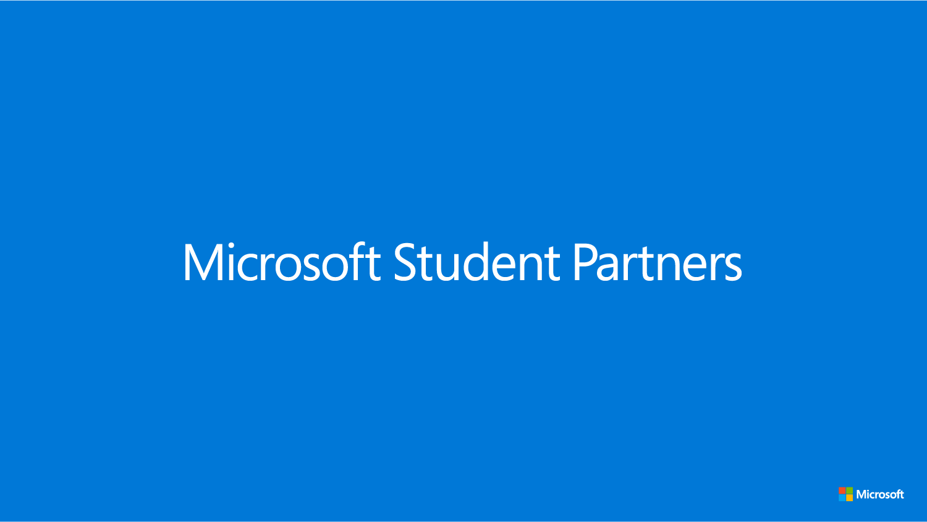
Stuff to help you communicate & collaborate…

Slide 6




Azure for Students Innovate with Azure for free using your preferred tools and open source
Verify as a student
$100 annual credit
25+ Free products
Dev Tools
Pay nothing
No credit card required
Ability to convert to Pay As You Go
12 mos or until $100 credit is used
https://aka.ms/azureforstudents

Slide 7
Stuff to help you learn, skill-up, and be recognized…

Slide 8
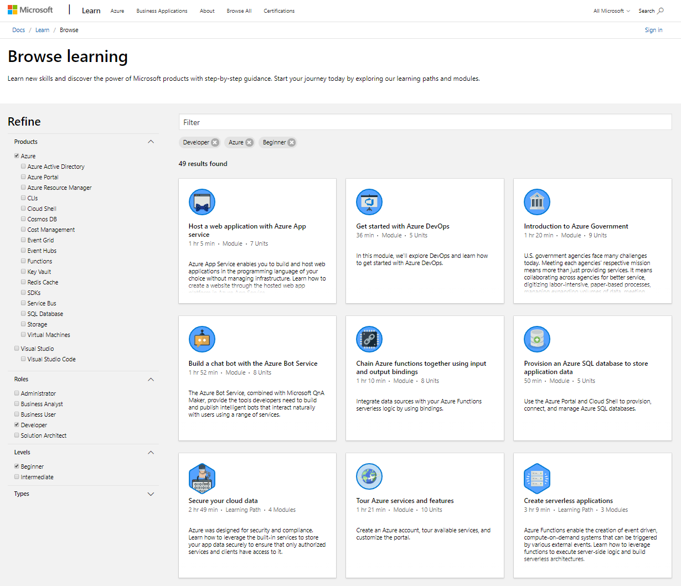
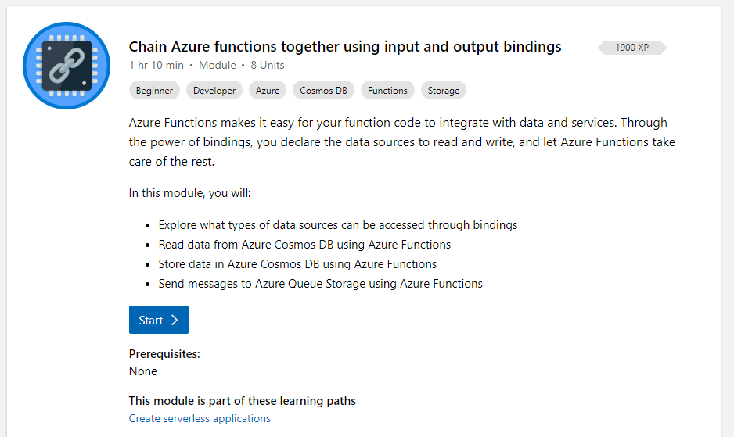
Microsoft Learn is growing…
https://docs.microsoft.com/learn/

Slide 9
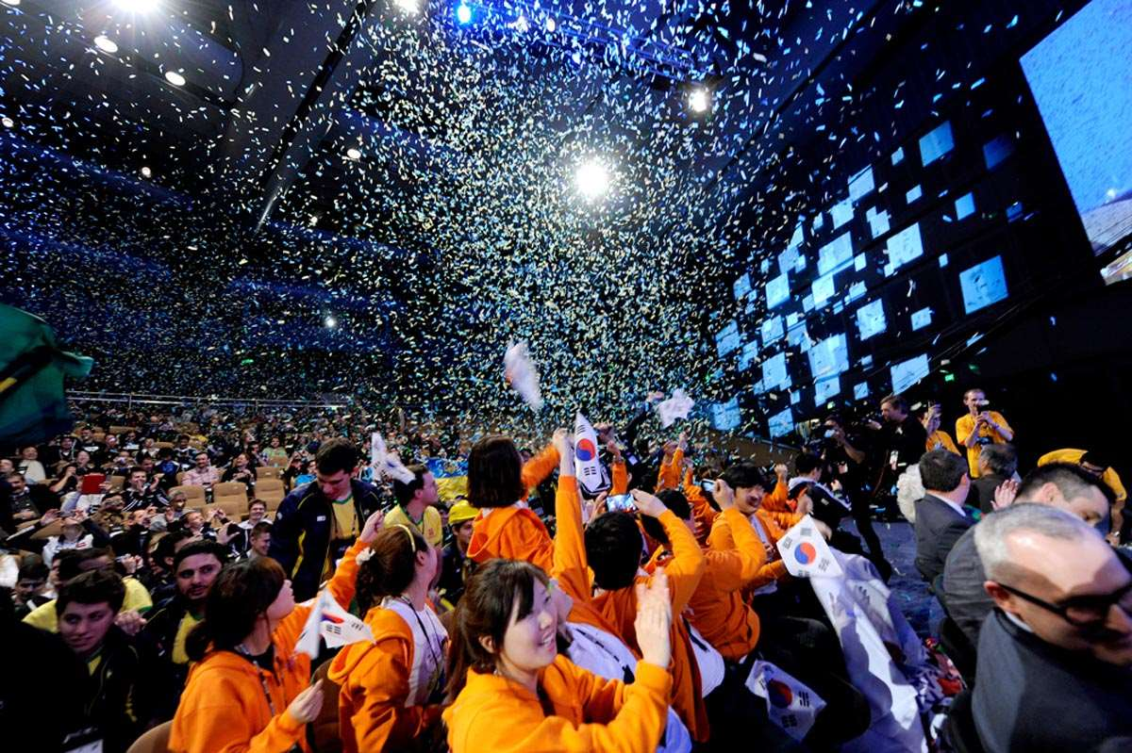


Dream it.
Innovative projects from student teams across the globe
Build it.
Skilled student devs bringing their ideas to life with Azure
Live it.
First class in-person experience and exposure
http://imaginecup.com

Slide 10
Imagine Cup
The Imagine Cup is more than just a tech competition. It’s a chance to work with friends, gain new skills, and meet other students from across the globe who want to make a difference.
Three in-person Regional Finals in Asia, EMEA and the Americas giving competitors and our audience a regionally relevant event to showcase all the amazing student projects
ImagineCup.com/Asia – ImagineCup.com/EMEA – ImagineCup.com/Americas
Teams will compete in Online Regional Finals for a chance to advance to in-person Regional Finals in Australia, Netherlands, and the USA.
The teams will compete for over $20,000 in prizing at each Regional Final
The 1st place team from each region will advance to the World Championship for a chance at $100,000 and to take home the Imagine Cup
Notes:
One unified, low-friction path towards modern cloud skills-building for students, faculty, and institutions

Slide 11
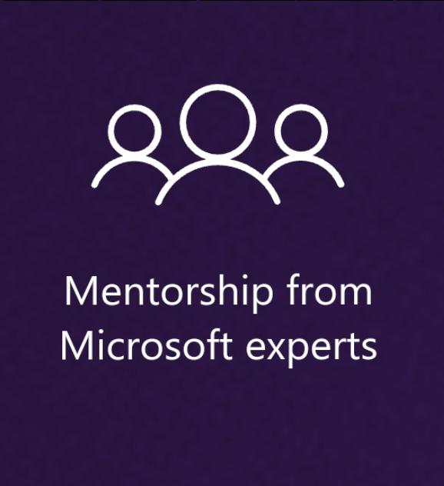
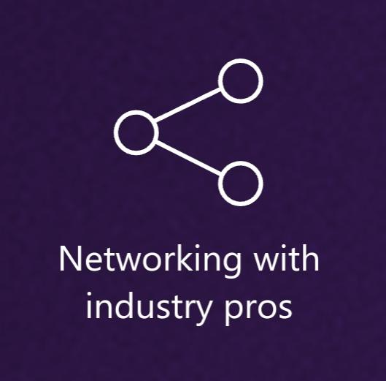

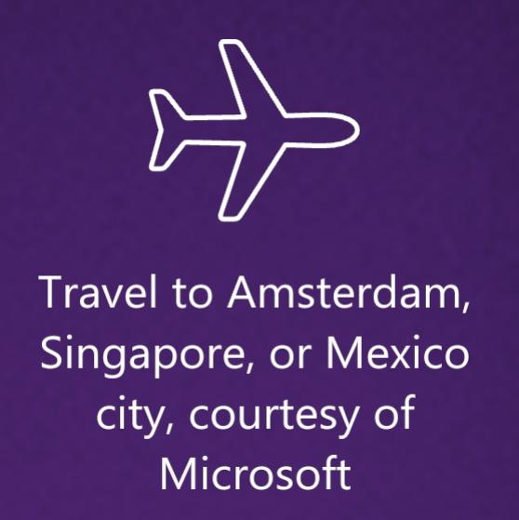
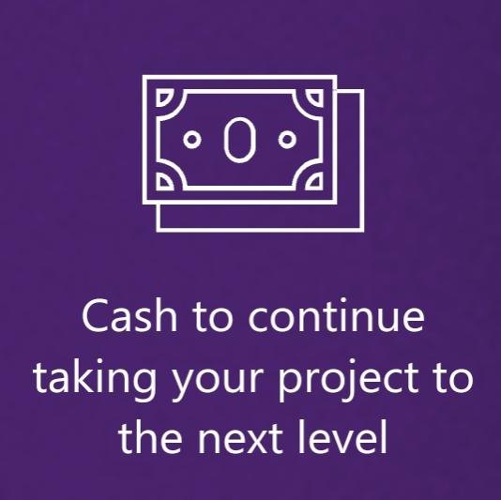
You could win...

Slide 12
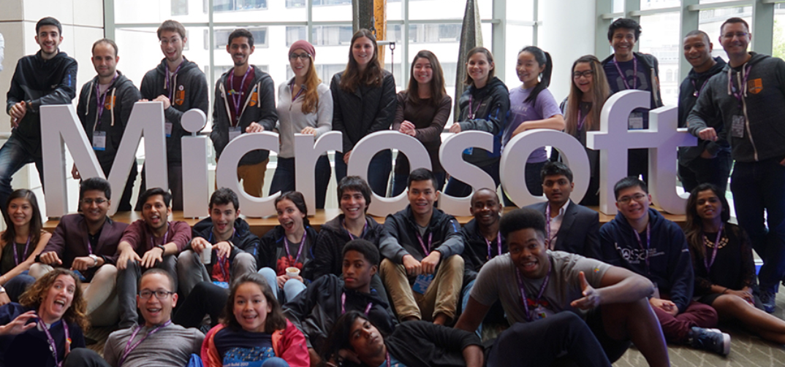
MSP Regional Summits
A select group of MSPs to attend one of the three Regional Summits
Learn, grow, and network with fellow MSPs and professional developers
Co-located with Microsoft Ignite | The Tour and Imagine Cup Regional Finals
Travel, hotel, food everything is managed by Microsoft.
Summit happens in three regions namely, Asia, EMEA and America.
Notes:
One unified, low-friction path towards modern cloud skills-building for students, faculty, and institutions

Slide 13

MSPs can get free certs
https://www.microsoft.com/learning/ browse-new-certification.aspx
Would you like to get certified?
Write a blog post or record a video tutorial to help others learn a concept required for the Azure exam and report to MSP-Help@Microsoft.com.
Attend a Microsoft Ignite the Tour and avail the benefits.

Slide 14
Stuff to help you on-campus and online…

Slide 15
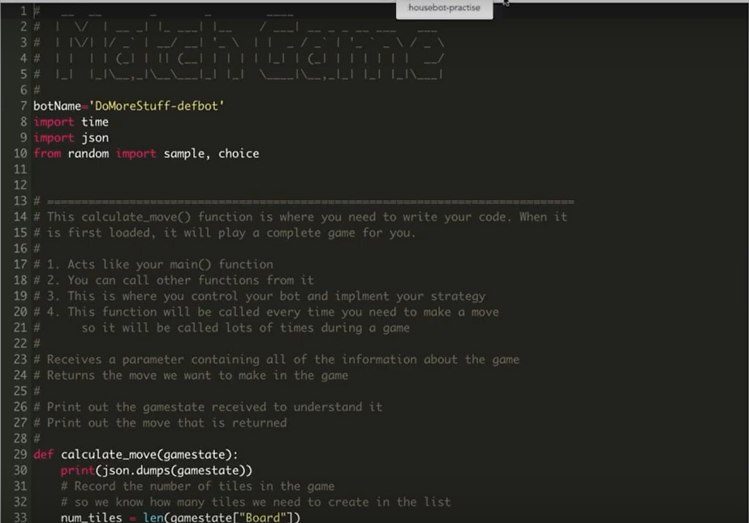
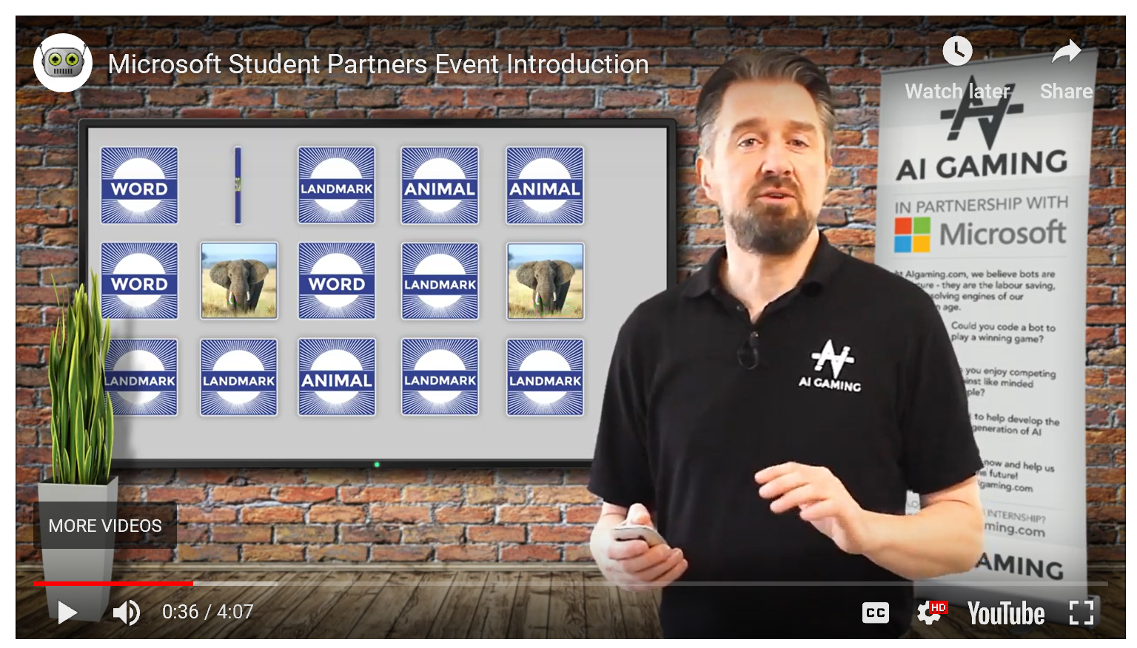
AI Gaming | MSP Digital Tournament
Plan and lead your own AI Gaming competition on your campus or online!
Challenge: Who can build the fastest machine learning model to play a card-matching game?
Minimal set-up required. Python-editor, instructions, tournament, and how-to are all online.
Use Azure Cognitive Services to enhance matching through Computer Vision and Text Analytics
Start exploring this: https://help.aigaming.com/more-information/msp-event.

Slide 16
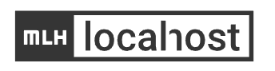
Major League Hacks LocalHost
Want an easy way to skill-up and lead your first workshop?
Try leading an MLH LocalHost workshop! https://localhost.mlh.io/
Great way to earn credibility and recognition in both MLH and MSP communities
All tech resources are provided. You only need to arrange the event itself.
4 Azure-focused modules to choose from:
Build and deploy node.JS apps
Add a FAQ Bot to your website
Build a Blockchain Ratings App
Analyze and Transcribe Videos

Slide 17
Stuff to help you organise a virtual event...

Slide 18
Information regarding the Virtual Events
The event must be held on Microsoft Teams meeting hosted on Student Partner Teams.
A minimum number of 15 participants must be present during the Team call.
The meeting should be recorded and it’s link should be submitted in the reporting tool.
You can also invite CPMs for the calls for your support.

Slide 19
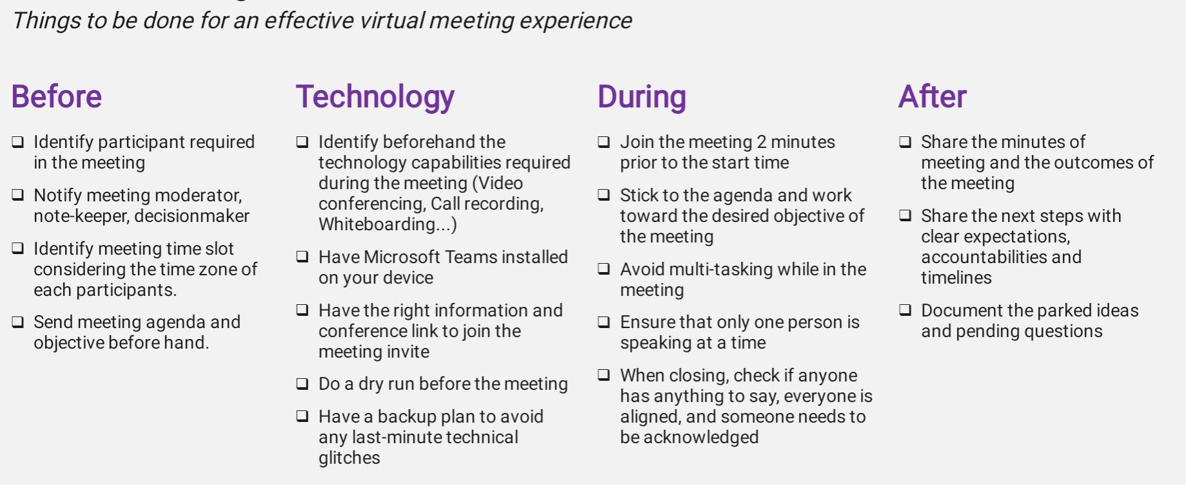
Virtual Meeting Checklist

Slide 20
It's not over yet... We have more for you...

Slide 21

MSP Developer Stories Contest
A monthly contest created for the Microsoft Student Partners.
Region : India only as of now.
Goal : To skill Microsoft Student Partners to learn new technologies on MS Learn and write technical blogs with demos, code samples sharing your experiences while building on Azure.
Topic : AI and ML - April, May & June 2020.
Two winners each month will receive a cool Microsoft developer swag pack delivered to their doorstep and chance to get your story featured on Microsoft Educator Developer.
For more details- https://aka.ms/msp-dev-stories-india

Slide 22
In summary…

Slide 23
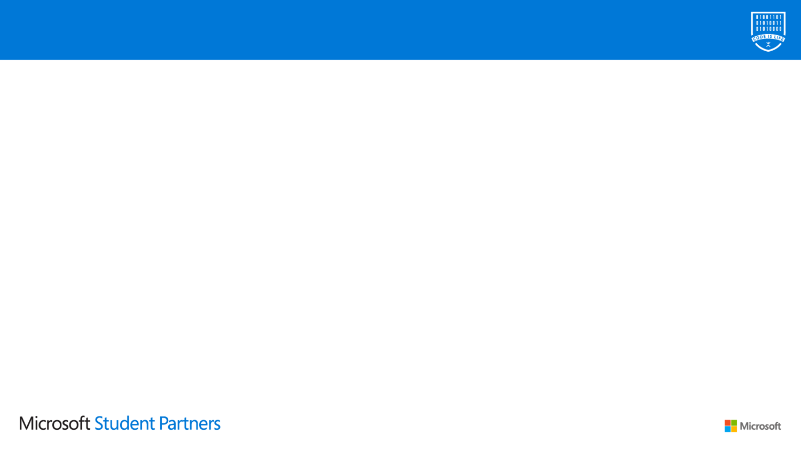
All the benefits in one place.
Everyone gets:
$150 monthly of Azure Cloud
Office 365 subscription
Visual Studio subscription
6-month LinkedIn subscription including LinkedIn Learning
TechSmith offer for Snagit and Camtasia
MSP community, mentorship, events..etc
We help with events you lead:
GitHub repo of labs, demos, talks
Partnerships: AI Gaming, MLH LocalHost
Subway (most countries)
Reimbursements (4 countries so far)
Videos and live guidance on Teams
We help you get recognized:
Leadership opportunities on your resume
MSP Summits & major Microsoft events
More to come…

Slide 24
Our aim
We want you to learn, experiment, build something you love.
with open source libraries, on Linux or Windows or Mac, with an IDE, in a CLI, in mixed reality, in human reality, on your device, on a server, on a cloud, with the people you like, with people who might become your friends, and so on…
We’re about enabling your success through our community and products.

Slide 25
What we’re asking you to do….
Learn
Connect
Share

Slide 26
How to Apply
https://studentpartners.microsoft.com/
Login
Fill Personal Details
Answer Simple questions
What excites you about technology and why you want to help other students explore and learn?
How would you take a technical concept and teach it to a friend or peer that has never heard of it?
If you were hosting an event at your school, how would you get students to attend ?
Make a video of 2 minutes and share the link in the form
Submit & wait for the result!

Slide 27
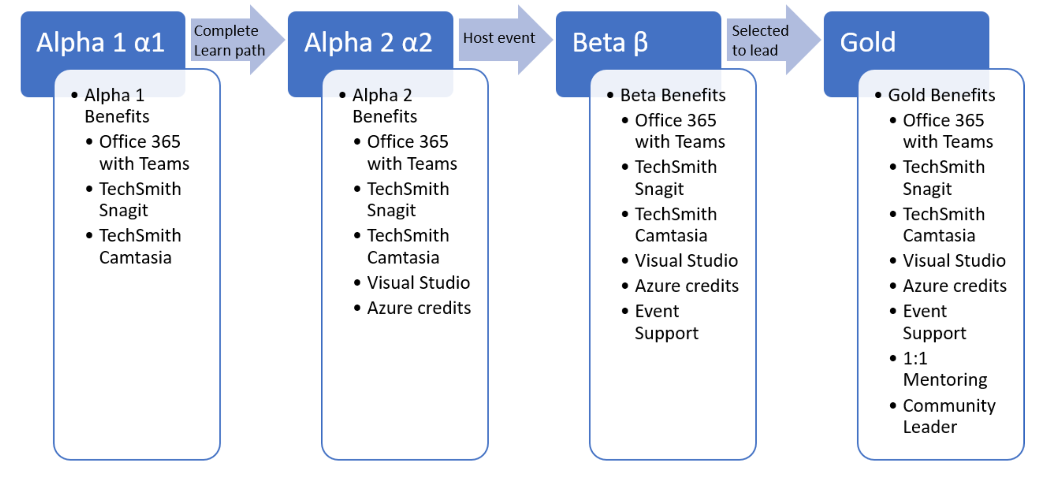
Badges, Benefits and Program Milestones
As you progress through the program and complete various activities, you will advance program milestones, earn program badges and unlock program benefits. There are 4 program milestones and they are called Alpha 1, Alpha 2, Beta and Gold.

Slide 28


Slide 29
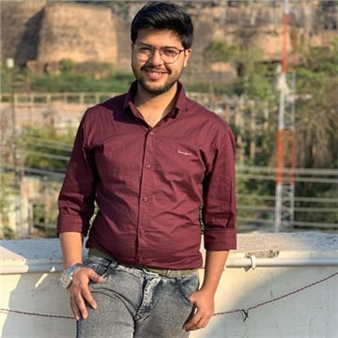
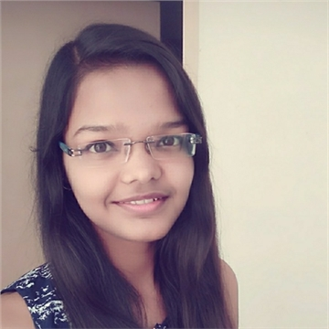
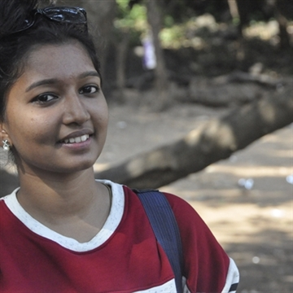
Connect with us!
Microsoft Student Partners
Chirag Sharma
Nancy
Lakshmi Seemakurthi
Nancy@studentpartner.com
linkedin.com/in/nancy011
cschiragsharma72@studentpartner.com
SaiLakshmi@studentpartner.com
linkedin.com/in/chirag-sharma-3a96b216b
twitter.com/SaiLakshmiSV?s=09
twitter.com/ChiragS92785609?s=09

